Slide 1
Sunny Hill Health Centre Student EIP Initiative
Student’s Name
Supervisor(s) Name
Discipline
Date

Slide 2
Title of Talk
BRIEF EVIDENCE INFORMED ASSESSMENT
OF THE RESEARCH
(BEAR)
Notes:
www.childdevelopment.ca/Libraries/Learning_Opportunities/BEAR_Rapid_Clinical_Query_Worksheet.sflb.ashx

Slide 3
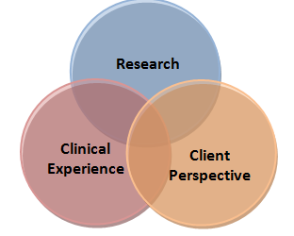
Background
Notes:
Why is this important?
How did your clinical question arise?
Is there a practice gap?
Important: Ensure to include findings from clinicians’ experience (gained through discussion with your preceptor(s)) and the client perspective (when able) as well as considerations gained from discussions within your team (i.e. with other clinicians). If you have not discussed these considerations with your team then address it in the “Discussion” slide at the end of your presentation.
*Please see second link below for additional information
http://www.childdevelopment.ca/Libraries/EBP_Flowcharts/Step_1_Formulating_Your_Clinical_Question.sflb.ashx
&
*http://www.childdevelopment.ca/Libraries/Evidence_for_Practice/ClinicalDecisionMakingWorksheetBuildingYourRationale.sflb.ashx

Slide 4
Clinical Question/PICO
P:
I:
C:
O:
Notes:
http://www.childdevelopment.ca/Libraries/EBP_Flowcharts/Step_1_Formulating_Your_Clinical_Question.sflb.ashx

Slide 5
Search
Search Sources
Search Terms
Notes:
http://www.childdevelopment.ca/Libraries/EBP_Flowcharts/Step_2_Searching_for_Evidence.sflb.ashx

Slide 6
Best Evidence Identified
S1
S2
S3
S4
S5
S6
Notes:
Move the arrow to indicate where the best evidence was found. (You may have more than one arrow if you are utilizing more than one article, from more than one level of pre-appraised evidence ( e.g. a systematic review and a guideline) - however typically this is not the case as typically you would want to use the highest level of evidence.
http://www.childdevelopment.ca/Libraries/EBP_Flowcharts/Step_3_Appraising_the_Evidence.sflb.ashx

Slide 7
Best Evidence
BEST EVIDENCE
(TOP 2 or 3)
List:
Author’s Name, Year
Author’s Name, Year
Author’s Name, Year
TYPE OF EVIDENCE
List - for example:
S1- Primary Research
or
S3 - Systematic Review
Notes:
www.childdevelopment.ca/Libraries/Learning_Opportunities/BEAR_Rapid_Clinical_Query_Worksheet.sflb.ashx

Slide 8
Author/Title of Article
Purpose(s):
Population:
Notes:
www.childdevelopment.ca/Libraries/Learning_Opportunities/BEAR_Rapid_Clinical_Query_Worksheet.sflb.ashx

Slide 9
Rapid Appraisal (Name of Author)
Strengths
Notes:
Strengths-- based on conduct questions found in BOTH:
1) Rapid Appraisal
For example:
AACPDM Conduct Questions for Single Subject or Group Designs
Or
AMSTAR for Systematic Reviews
2) Clinical Applicability Form
www.childdevelopment.ca/Libraries/Learning_Opportunities/BEAR_Rapid_Clinical_Query_Worksheet.sflb.ashx
http://www.childdevelopment.ca/Libraries/EBP_Flowcharts/Step_3_Appraising_the_Evidence.sflb.ashx

Slide 10
Rapid Appraisal (Name of Author)
Weaknesses:
Notes:
Weaknesses based on conduct questions found in BOTH:
1) Rapid Appraisal
For example:
AACPDM Conduct Questions for Single Subject or Group Designs
Or
AMSTAR for Systematic Reviews
2) Clinical Applicability Form
www.childdevelopment.ca/Libraries/Learning_Opportunities/BEAR_Rapid_Clinical_Query_Worksheet.sflb.ashx
http://www.childdevelopment.ca/Libraries/EBP_Flowcharts/Step_3_Appraising_the_Evidence.sflb.ashx

Slide 11
Key Messages for Action
Notes:
www.childdevelopment.ca/Libraries/Learning_Opportunities/BEAR_Rapid_Clinical_Query_Worksheet.sflb.ashx

Slide 12
Repeat for each study
Repeat slides 8−11 for each study

Slide 13
Clinical Bottom Line
Notes:
Summarize the overall findings in a statement that provides the main take-home message for clinicians.
www.childdevelopment.ca/Libraries/Learning_Opportunities/BEAR_Rapid_Clinical_Query_Worksheet.sflb.ashx

Slide 14
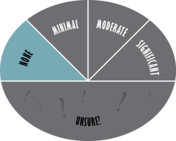
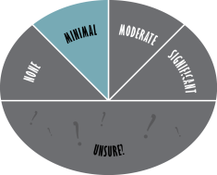
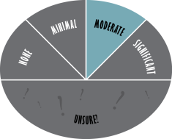
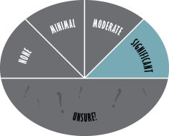
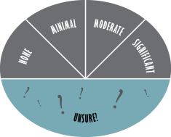
Recommendations for Degree of Practice Change Required
Notes:
Based on these findings and on current practice, what degree of change is required? Significant or Moderate or Minimal or None or Unsure ?
Pick the corresponding image (enlarge as needed) and delete the others
Then please list and discuss WHY.
http://www.childdevelopment.ca/Libraries/EBP_Flowcharts/Step_4_Applying_Evidence_to_Practice.sflb.ashx
Note: You can suggest recommendations for practice change considerations – such as Significant or Moderate or Minimal changes or None or Unsure ---- even if the evidence is weak however ensure to make this clear and highlight that follow up and measurement will be needed due to decreased confidence in these new findings/recommendations.

Slide 15
Recommendations for Practice Change (if warranted)
Notes:
List what kind of actions or practice changes ( if warranted) you recommend.
http://www.childdevelopment.ca/Libraries/EBP_Flowcharts/Step_4_Applying_Evidence_to_Practice.sflb.ashx
You can make recommendations for practice change considerations even if the evidence is weak however ensure to make this clear and highlight that follow up and measurement (see next slide) will be needed due to decreased confidence in these new recommendations/findings.

Slide 16
Measurement
Notes:
Provide recommendations regarding 1 or 2 measurement tools that should be used to evaluate outcomes when implementing the intervention you’ve presented. This would be a measurement tool(s) that would allow for consistency between clinicians and improved communication regarding outcomes – to ensure that the same construct is being measured in a standardized method. Dependent on the population more than one measurement tool may be needed. Possible measures, and databases of measurement tools are provided in the following linked presentation:
http://www.childdevelopment.ca/Libraries/Evidence_Center_Step2/Measurement_Tools_for_SAT_July_2015-1.sflb.ashx

Slide 17
Implementation/Knowledge Translation Recommendations for Practice Change
Notes:
To achieve these actions or practice changes (if warranted) list a few Knowledge Translation (KT) methods/strategies re how this practice change would best be achieved (see links below if this hyperlink is not working) :
Remember: Note and comment on whether the KT methods you have selected to use are passive vs. active and what the expectations might be when only passive strategies are used vs a combination of active and passive strategies. KT strategies also have evidence behind them – choose green light over yellow or red light interventions for these too.
Please be specific in use of which KT strategy you recommend ( i.e. use the title of the KT strategy as listed in the linked resource) so an to be consistent with KT literature – please see:
http://www.childdevelopment.ca/Libraries/Evidence_Center_Step4/Knowledge_Translation_Methods.sflb.ashx
Also see link below for more information:
http://www.childdevelopment.ca/Libraries/EBP_Flowcharts/Step_4_Applying_Evidence_to_Practice.sflb.ashx
You can make recommendations for practice change considerations even if the evidence is weak however ensure to make this clear and highlight that follow up and measurement will be needed due to decreased confidence in these new recommendations.
Feel free to duplicate this slide if you need more space to share your recommendations.

Slide 18
Recommendations for Resource Development (if appropriate)
Notes:
Add here what you would recommend be developed to further support knowledge and practice changes:
Eg:
Handout
Pamphlet
Checklist
You can make recommendations for practice change considerations even if the evidence is weak however ensure to make this clear and highlight that follow up and measurement will be needed due to decreased confidence in these new recommendations.

Slide 19
Discussion
Notes:
Remember: As mentioned earlier – see “Background” slide - ensure to include clinical experience (gained through discussion with your preceptor(s)) and the client perspective (when able) as well as considerations gained from discussions within your team (i.e. with other clinicians). If you are not able to discuss considerations with your team then ensure to raise this now with those attending. *Please see link below for additional information regarding points you can raise to enhance dialogue and discussion.
*http://www.childdevelopment.ca/Libraries/Evidence_for_Practice/ClinicalDecisionMakingWorksheetBuildingYourRationale.sflb.ashx

Slide 20
References

